Slide 1

The Endocrine system
Dc 7900 - 7919
Guy Arnold
Field Veteran Service Officer

Slide 2
overview
What is the “Endocrine System”
What makes up the Endocrine System
38 CFR 4.119 (DC 7900 – 7919)
Endocrine System Condition Ratings
One the top endocrine issues filed for and its ratings
  Diabetes Mellitus
Secondary Conditions

Slide 3
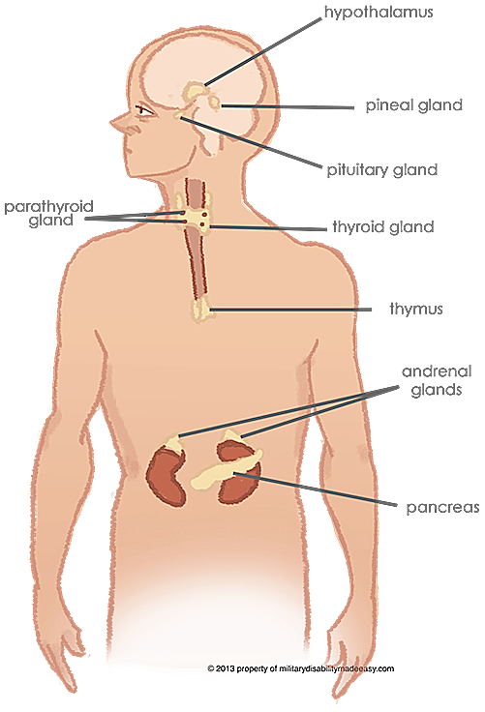
What is the Endocrine system?

Slide 4
The Endocrine System is a network of glands that create hormones to help regulate the body. These hormones control the growth of new cells and metabolism. Some organs, like the kidney, also help in producing hormones.

Slide 5
What is the Endocrine system made up of?
The Endocrine System is made up of the hypothalamus, thymus, pituitary gland, thyroid gland, parathyroid glands, adrenal glands, pineal gland, reproductive glands (ovaries or testes), and the pancreas. All these parts work together to keep the body in balance.

Slide 6
The Endocrine system
38 CFR 4.119
Diagnostic codes 7900 - 7919

Slide 7
7900 - Hyperthyroidism
7901 - Thyroid enlargement, toxic
7902 - Thyroid enlargement, nontoxic
7903 - Hypothyroidism
7904 - Hyperparathyroidism
7905 - Hypoparathyroidism
7906 - Thyroiditis
7907 - Cushing's syndrome
7908 - Acromegaly
7909 - Diabetes insipidus

Slide 8
7911 - Addison's disease (adrenocortical insufficiency)
7912 - Polyglandular syndrome (multiple endocrine neoplasia, autoimmune polyglandular syndrome)
7913 - Diabetes mellitus
7914 - Neoplasm, malignant, any specified part of the endocrine system
7915 - Neoplasm, benign, any specified part of the endocrine system

Slide 9
7916 - Hyperpituitarism (prolactin secreting pituitary dysfunction)
7917 - Hyperaldosteronism (benign or malignant)
7918 - Pheochromocytoma (benign or malignant)
7919 - C-cell hyperplasia of the thyroid

Slide 10
Endocrine System Condition Ratings
The VASRD (The Veteran Affairs Schedule for Rating Disabilities) offers ratings for the following conditions of the Endocrine System:
Diabetes
Conditions of the Thyroid
Conditions of the Parathyroid
Conditions of the Pituitary Gland
Conditions of the Adrenal Gland
Conditions affecting multiple Glands
Cancer and Tumors of the Endocrine System

Slide 11
If a condition is not directly listed on the Endocrine System Ratings page, it is rated under the code that best describes it or its dominant symptoms.
Ratings for conditions of the ovaries are included on the Female Reproductive System page, and ratings for conditions of the testes are included on the Genitourinary System page.
In addition to or instead of the standard disability compensation for Endocrine System conditions, complete loss of use of the reproductive organs may also qualify for Special Monthly Compensation.

Slide 12
One of the top endocrine issues that veterans file for:
Diabetes Mellitus

Slide 13
Diabetes Mellitus – DC 7913
Diabetes mellitus is a condition defined by persistently high levels of sugar (glucose) in the blood. There are several types of diabetes. The two most common are called type 1 diabetes and type 2 diabetes.
During digestion, food is broken down into its basic components. Carbohydrates are broken down into simple sugars, primarily glucose. Glucose is a critically important source of energy for the body’s cells. To provide energy to the cells, glucose needs to leave the bloodstream and get inside the cells.
An organ in the abdomen called the pancreas produces a hormone called insulin, which is essential to helping glucose get into the body's cells. In a person without diabetes, the pancreas produces more insulin whenever blood levels of glucose rise (for example, after a meal), and the insulin signals the body's cells to take in the glucose. In diabetes, either the pancreas's ability to produce insulin or the cells' response to insulin is altered.

Slide 14
Diabetes Mellitus Ratings
10% VA Disability Rating - Manageable by restricted diet only
This rating criterion means that if the veteran has been diagnosed with diabetes mellitus and has been told by his doctor to watch his blood sugar and what he eats, the VA will pay him at a 10% level. This level may not require insulin injections but will likely involve some fluctuations in blood pressure.

Slide 15
Diabetes Mellitus Ratings continued
20% VA Disability Rating - Requiring insulin and restricted diet, or; oral hypoglycemic agent and restricted diet
If a doctor prescribes a diabetic medication, in addition to a restricted diet, the VA will grant an increase to 20%. The medications are common oral hypoglycemic medications.

Slide 16
Diabetes Mellitus Ratings continued
40% VA Disability Rating - Requiring insulin AND restricted diet AND regulation of activities
Notice that the VA rating code includes “and’s” but no “or’s”. In order to qualify for this rating, the veteran must be on insulin, and on a restricted diet, and unable to pursue certain types of activities.

Slide 17
Diabetes Mellitus Ratings continued
60% VA Disability Rating - Requiring insulin AND restricted diet AND regulation of activities with episodes of ketoacidosis or hypoglycemic reactions requiring one or two hospitalizations per year or twice a month visits to a diabetic care provider, plus complications that would not be compensable if separately evaluated
Requiring insulin AND restricted diet AND regulation of activities. The rating code then adds new elements.
Episodes of ketoacidosis OR hypoglycemic episodes, requiring one of the following:
One or two hospitalizations per year; OR
Twice a month visits to diabetic care provider

Slide 18
Diabetes Mellitus Ratings continued
100% VA Disability Rating - Require insulin injections frequently. Have a restricted diet. Must regulate their physical activity. Have been hospitalized three times a year or more. Experiencing progressive weight loss or strength reduction.

Slide 19
Secondary Conditions Associated with Diabetes Mellitus
Diabetes is a lifelong, chronic, condition that can lead to severe complications across various human body organ systems. VA has recognized that some of these complications are so disabling that they may also receive a VA disability rating and be compensable as secondary service-connected conditions.
Diabetic peripheral neuropathy
Renal dysfunction / severe kidney issues
ED (Erectile Dysfunction) – K Award
Hypertension and/or high blood pressure
Skin conditions
Diabetic retinopathy and other eye conditions like conjunctivitis or cataracts
Heart attacks
Strokes
Other Cardiac and cardiovascular medical complication

Slide 20
Fact!!!
Diabetes and Agent Orange
There is no shortage of medical literature on the connection between type 2 diabetes and veterans who were exposed to Agent Orange in Vietnam, Korea, and Thailand. In fact, the VA’s 2015 Annual Benefits Report noted diabetes mellitus as a result of agent orange exposure as the 9th most prevalent service-connected disability of all compensation recipients, with an estimated 431,166 claims awarded.
In 2015, there were 1,347,883 disability compensation recipients of the Vietnam Era, constituting 32% of the veteran population receiving benefits. Do the math and you find that almost 32% of the Vietnam veterans receiving compensation have diabetes mellitus according to the Department of Veterans Affairs. Interestingly, 411,698 of those individuals are males.
Of course, these statistics are only reflective of the veterans receiving veteran’s disability compensation. Imagine what the statistics would be if they included non-service-connected veterans as well!

Slide 21
Thank you

